Slide 1

Factors explaining the intention to use a modern contraceptive Method
MASSON Moïse

Slide 2
Table of content
Problem to solve
Goal of the project
target audience
data source
Methodology
01
INTRODUCTION
Visualization and Insights
Machine Learning Models
problem faced
EXPLORATORY AND ANALYSIS
02
Solution to the problem
Further directions
DISCUSSION AND SOLUTION
03

Slide 3

INTRODUCTION
Some married women in my neighborhood, intended to use contraceptive method but didn’t know how to address this issue to her husband or her physicians. Using modern contraception is a challenging choice in the life of these married women. It’s was a source of conflict with their husband due to the socio-demographic characteristics of those two partners. According to me, it’s important for Family planning workers to identify factors that could influence the evolution of woman’s intention to use a modern contraceptive method.

Slide 4

Problem to solve
This analysis attempts to help Family Planning workers to better understand the characteristics of Haitian married women based on intentions to use a modern contraceptive method in order to establish a pathway for thinking about contraceptive demand by category of woman.

Slide 5

What is the goal of this project ?
Question Research ?
Goal of the project
The objective of this project was to profile categories of woman who intends to use modern contraceptive method and to identify the factors associated.
As my project aims to question married women's choice to use modern contraceptive methods. We are asking if if there is a profile that fits any socio-economic category of woman who intends to use contraception and could influence the choice of these women ?

Slide 6


Target Audience
The purpose of this project can be of interest to everyone, especially :
Ministry of Public Health and Population
International Organizations/Donors and NGOs
Working in reproductive health and family planning
Married woman and others

Slide 7


The data that used in this Analysis comes from the Mortality, Morbidity and Service Utilization Survey (EMMUS VI) conducted in 2016. These data are available upon request from the Ministry of Public Health and Population (MPHP).
Data Sources

Slide 8



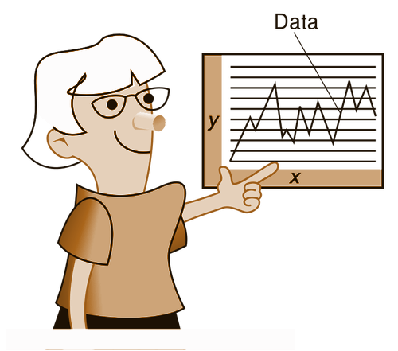
Methodology
Cleaning Data
Machin Learning
We have used python libraries to clean data selected
We have used algorithm of comparison to choose the best model
Presentation
Collect Data
Analysis
We have selected data that represent the socio-economic and demographic characteristics of married woman
After Descriptive and Bivariate Analysis we have We identified some important insights

Slide 9
Detection Keys Variables Process
Sociodemographic
Reproductive_factors
Economic_factors
Planning_factors
Keys Factors

Slide 10





Keys Factors
Woman’s Age
Cohabitation
Husband’s Age
Sex
Unions
After eliminating the collinear and strongly correlated variables(+85%), the remaining variables constitute the key variables. Five predictors related to the woman’s experiences have been identified. And by using logistic regression and a RandomForest Techniques, we determined the most important of the key variables: women's age.
Contraception
Contraception

Slide 11
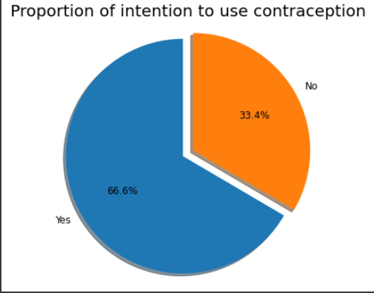

EXPLORATORY DATA ANALYSIS
33.4% of women expressed interest in using a modern contraceptive method later

Slide 12
Insights
50 %
23, 38%
Intend to use MCM for limiting children birth
Jupiter
Intend to use it for Spacing children birth
26,61%
Do not yet have a reason to use it

Slide 13
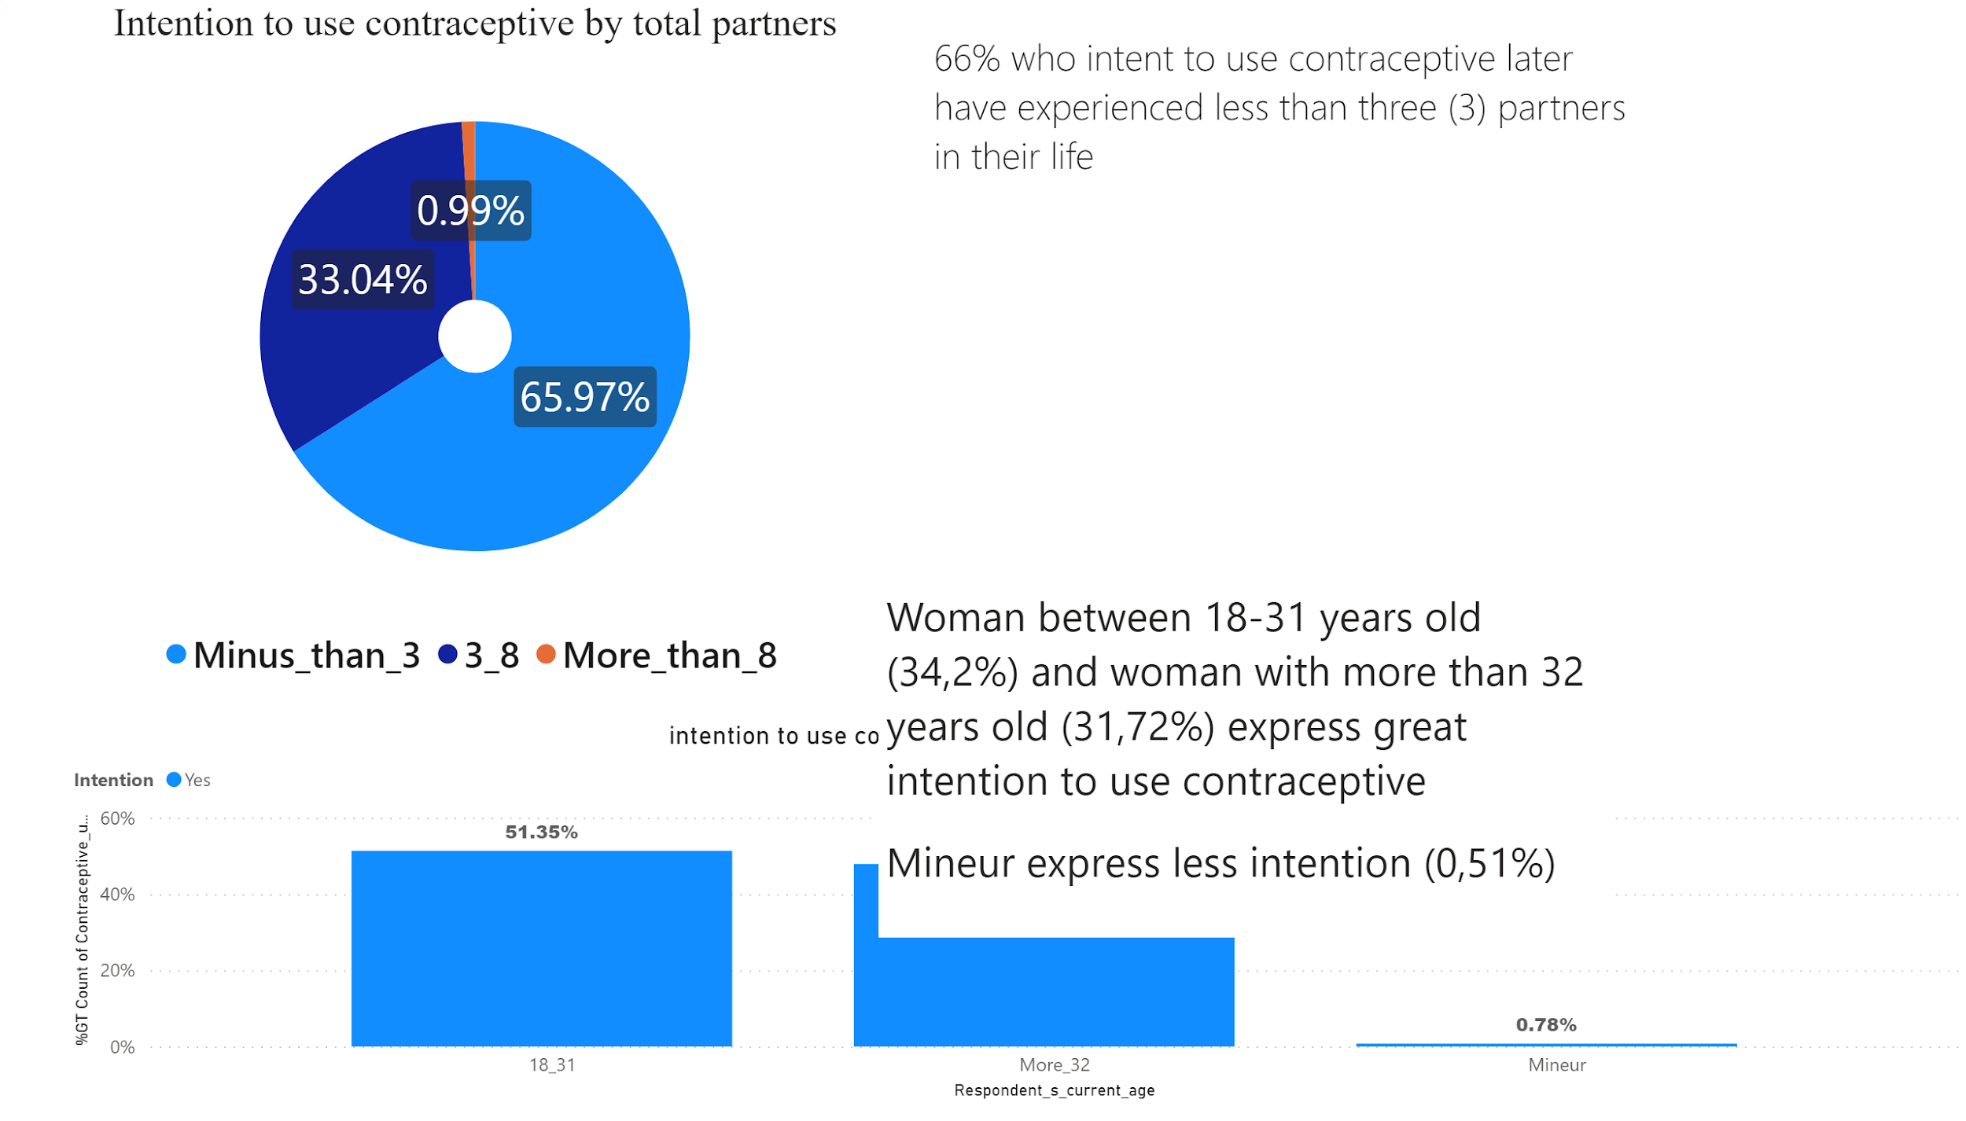

Slide 14
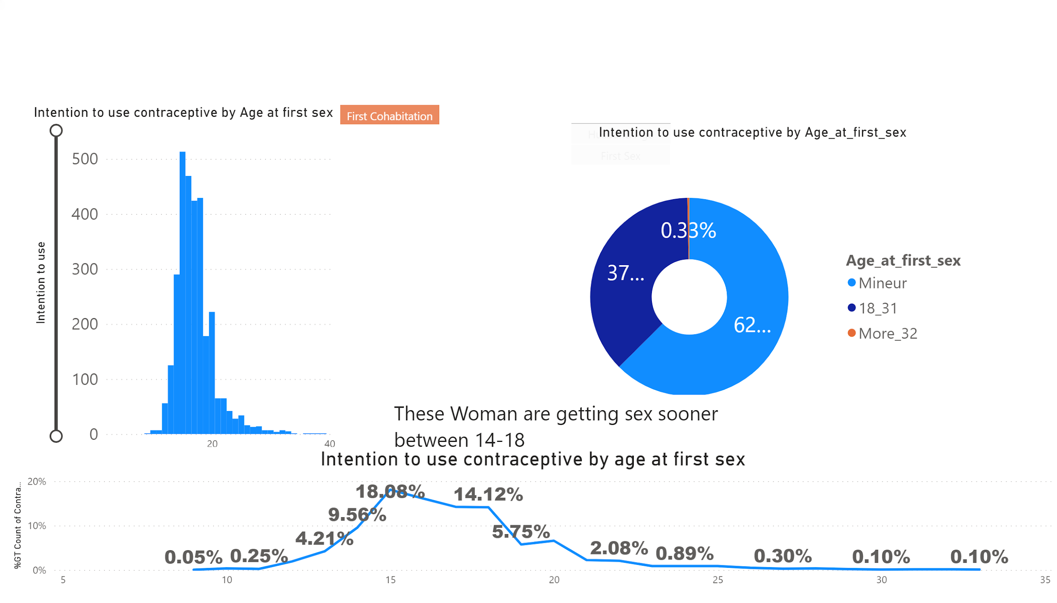

Slide 15
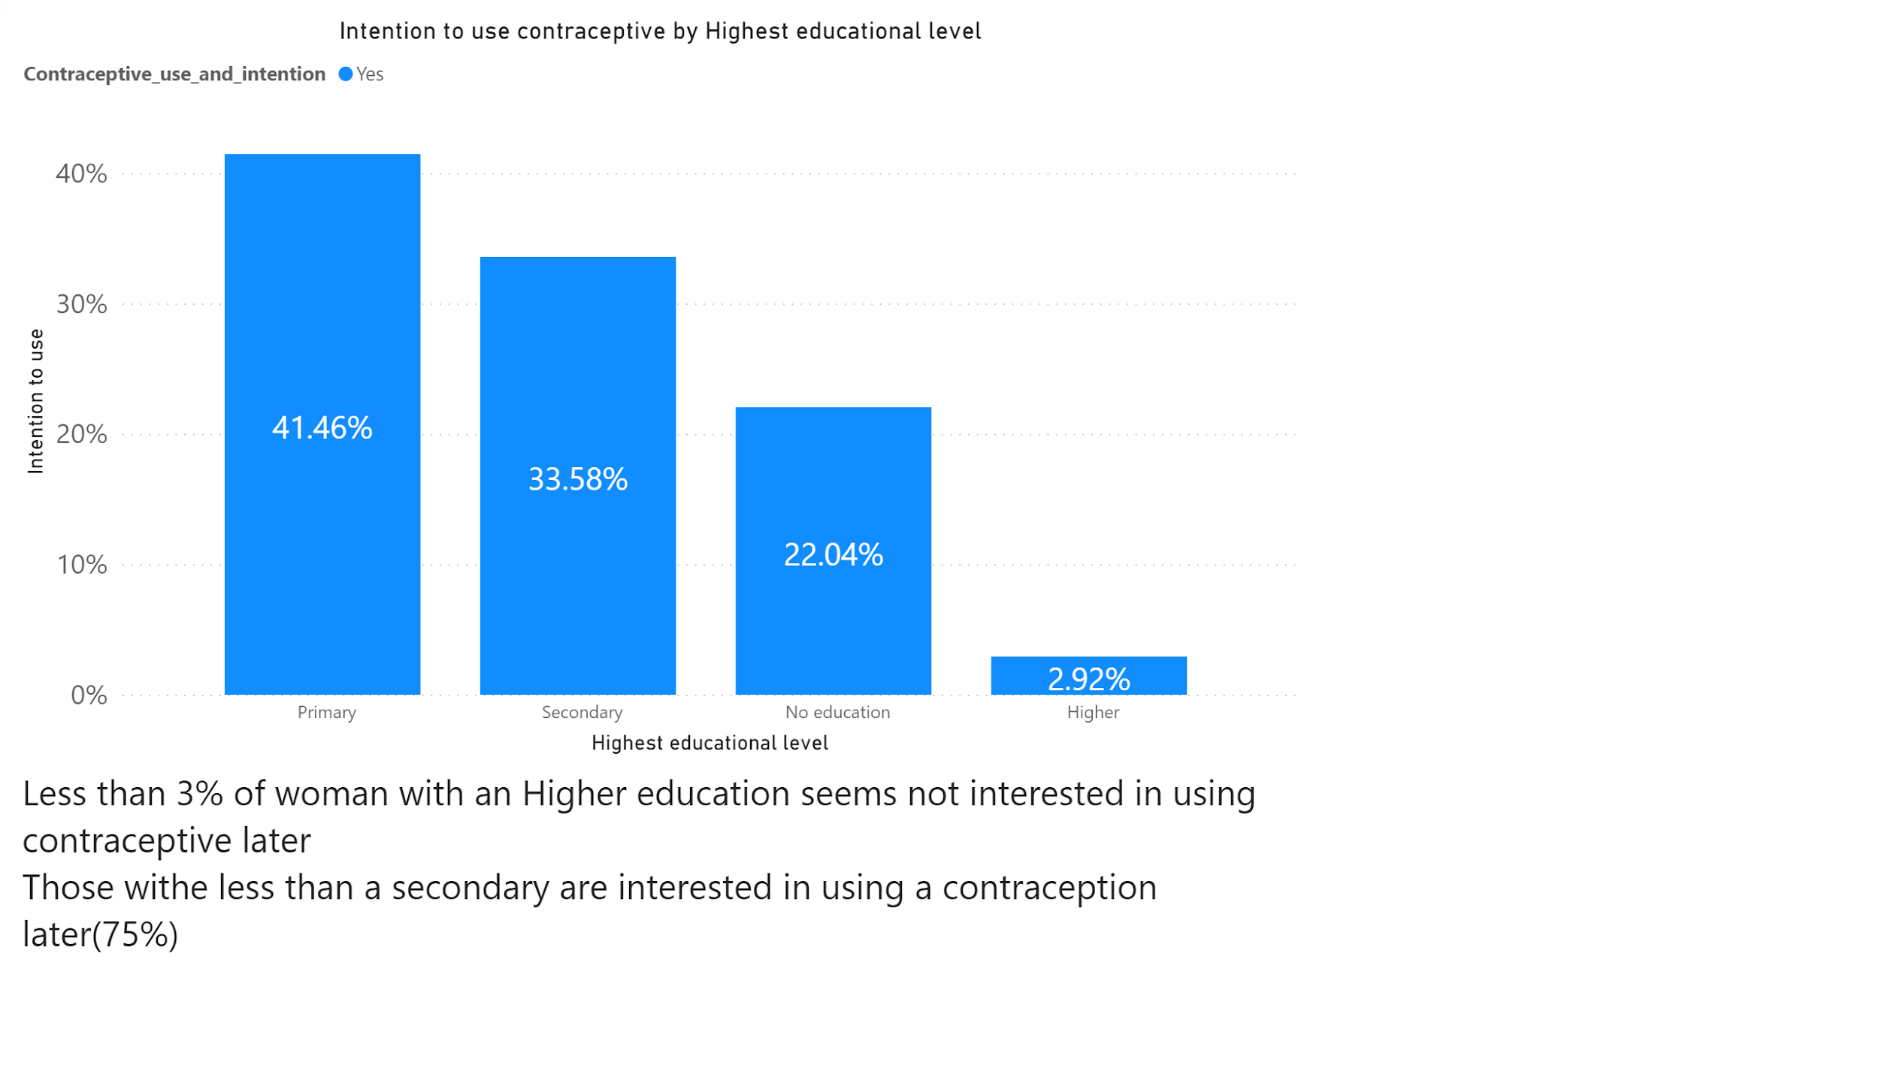

Slide 16
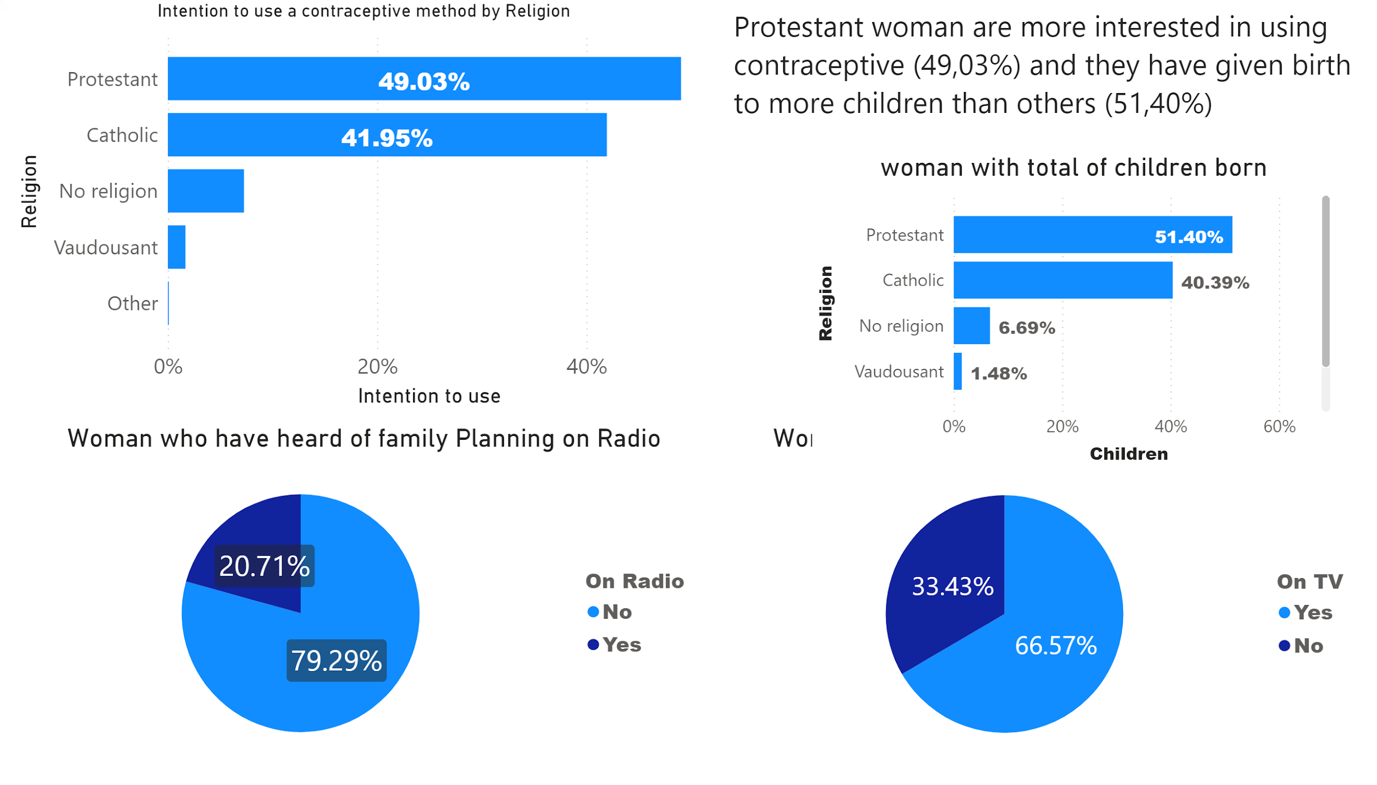

Slide 17
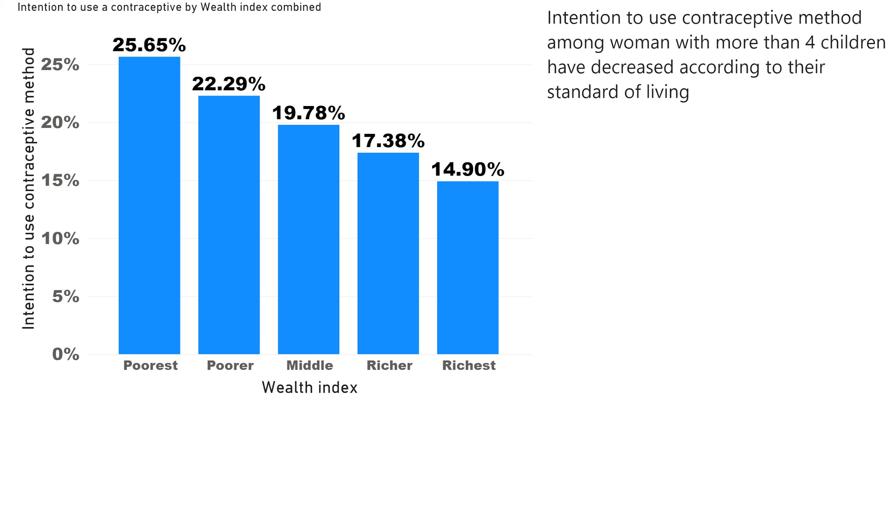

Slide 18
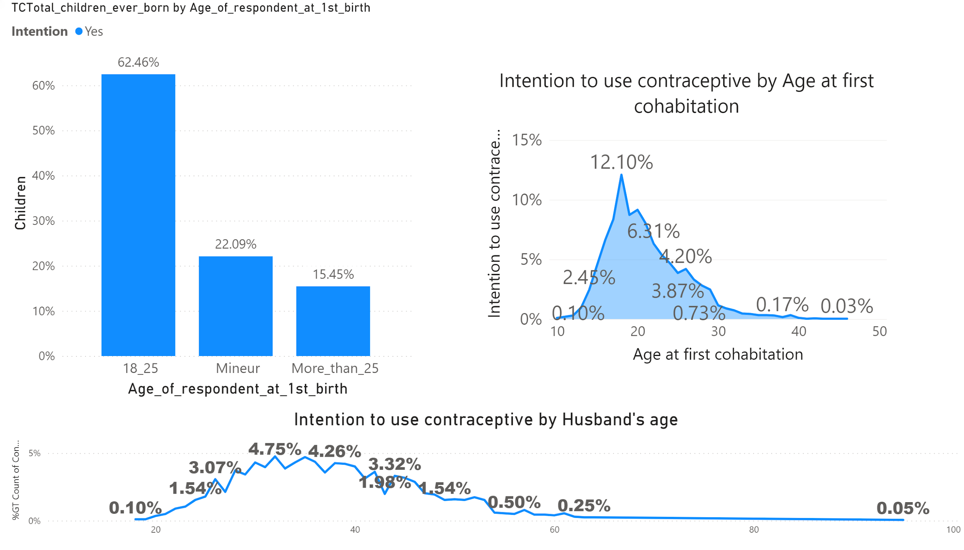

Slide 19
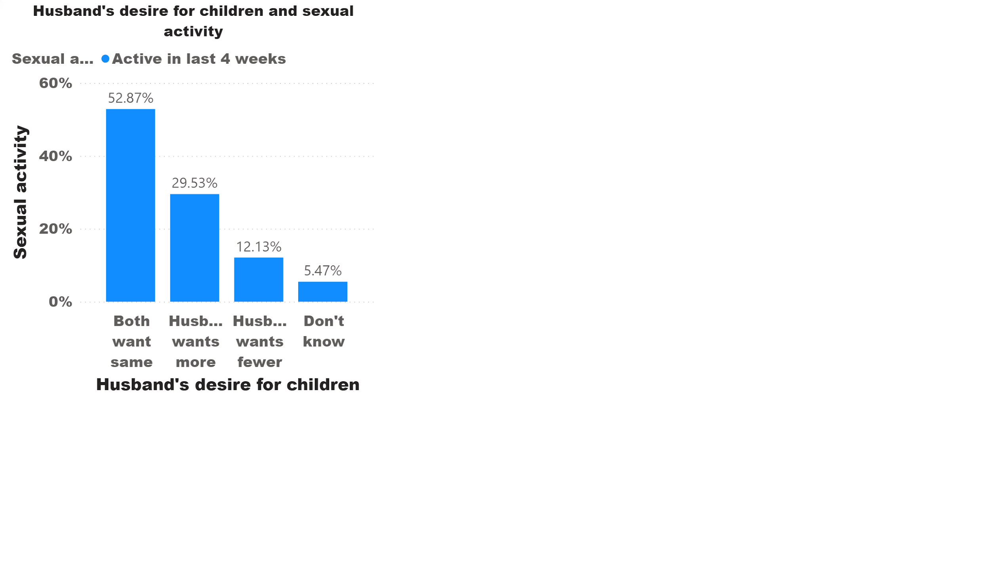

Slide 20
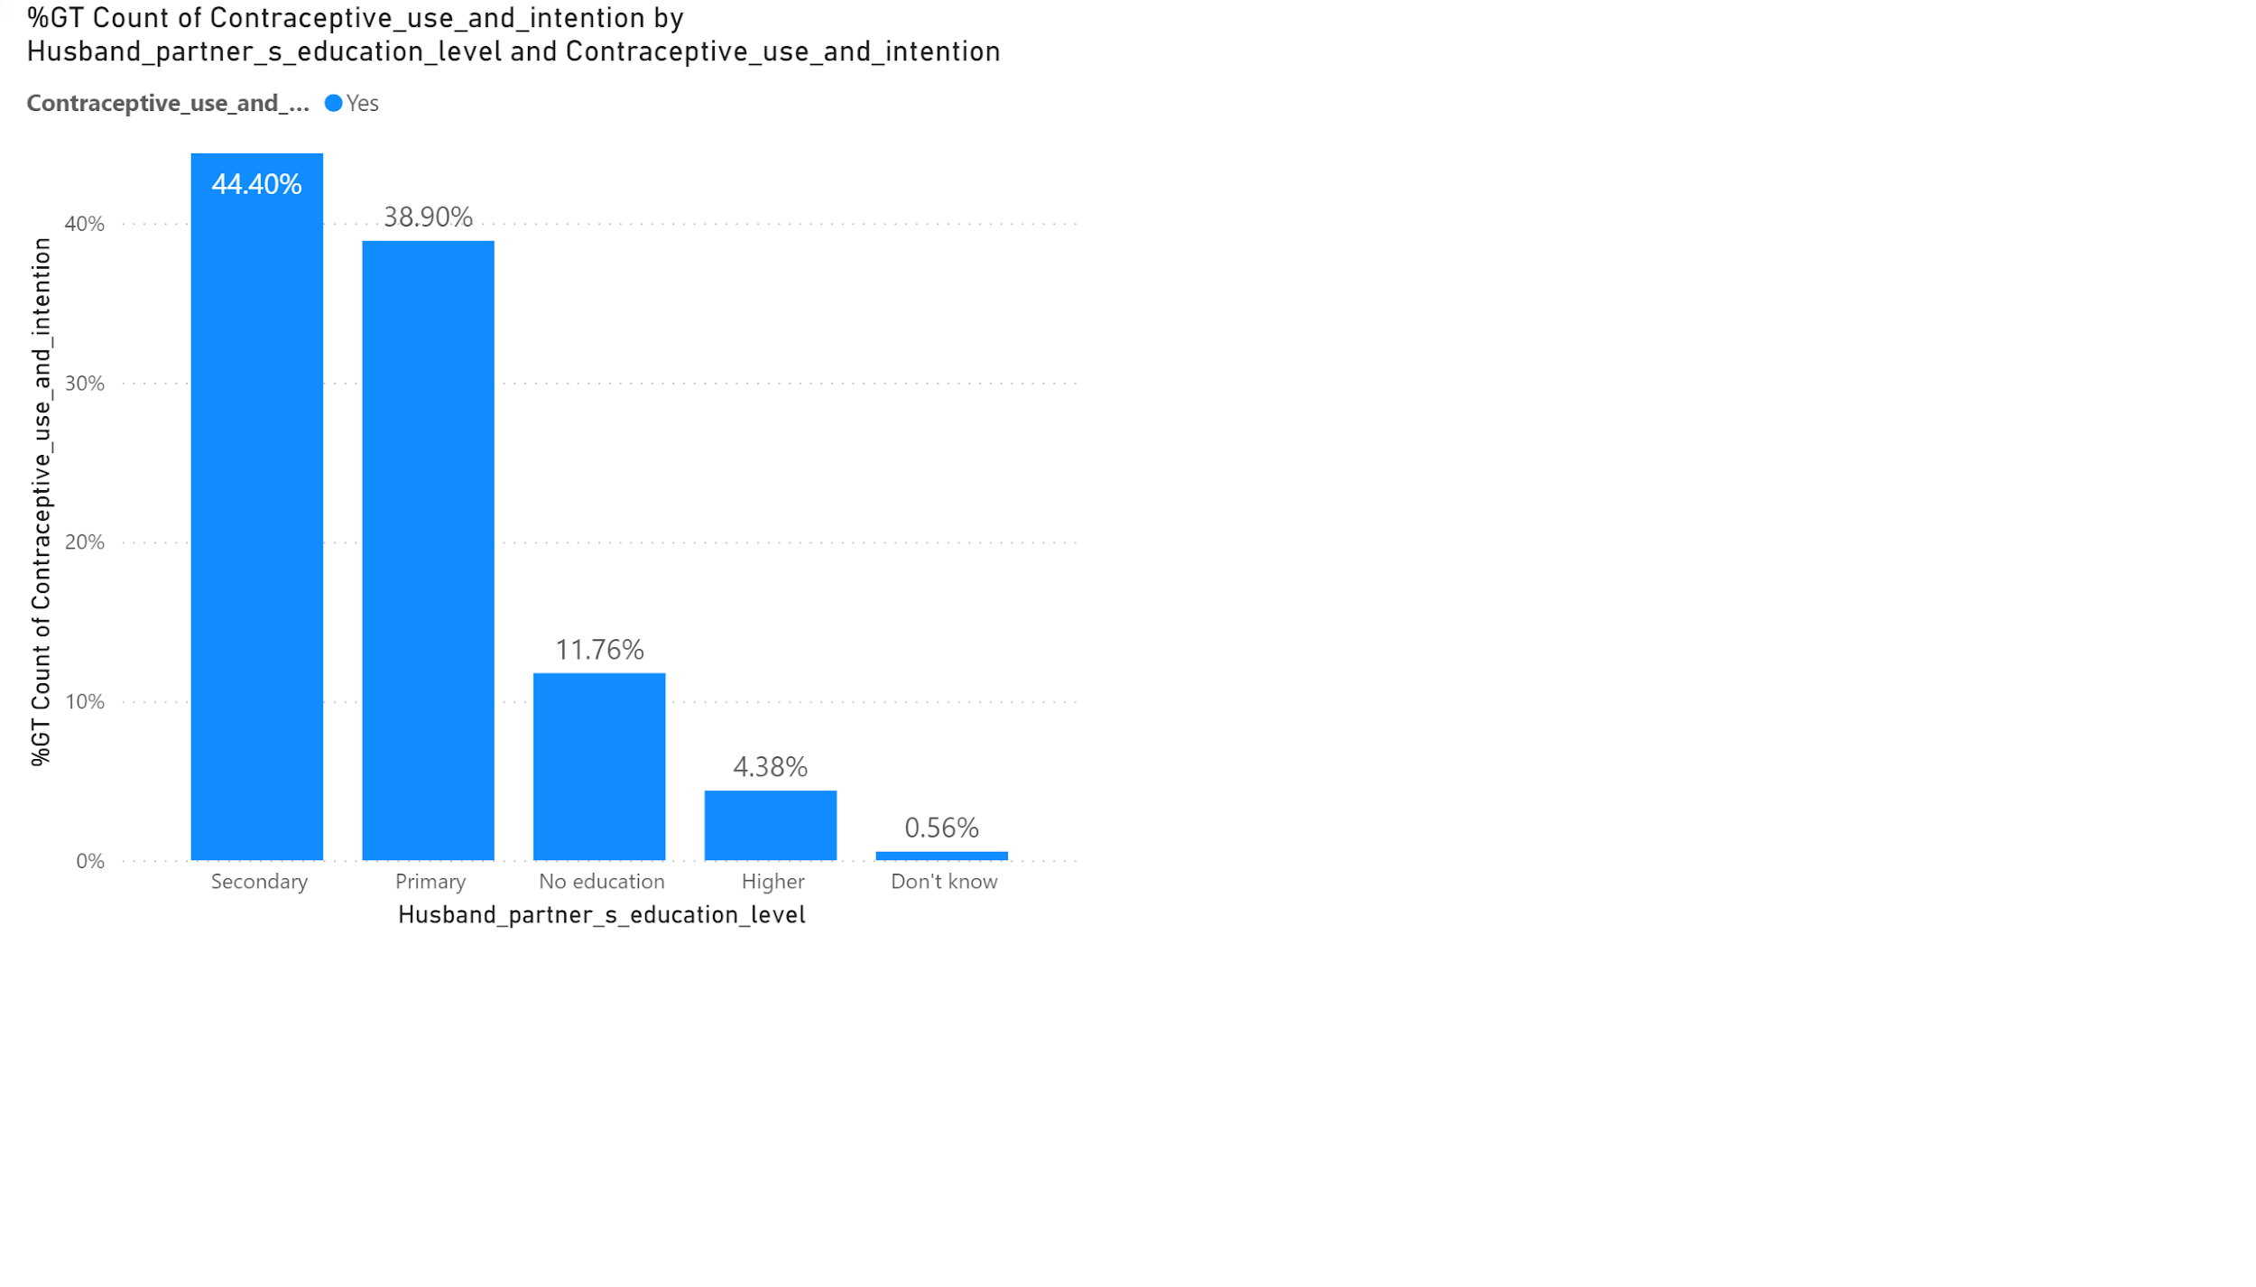

Slide 21
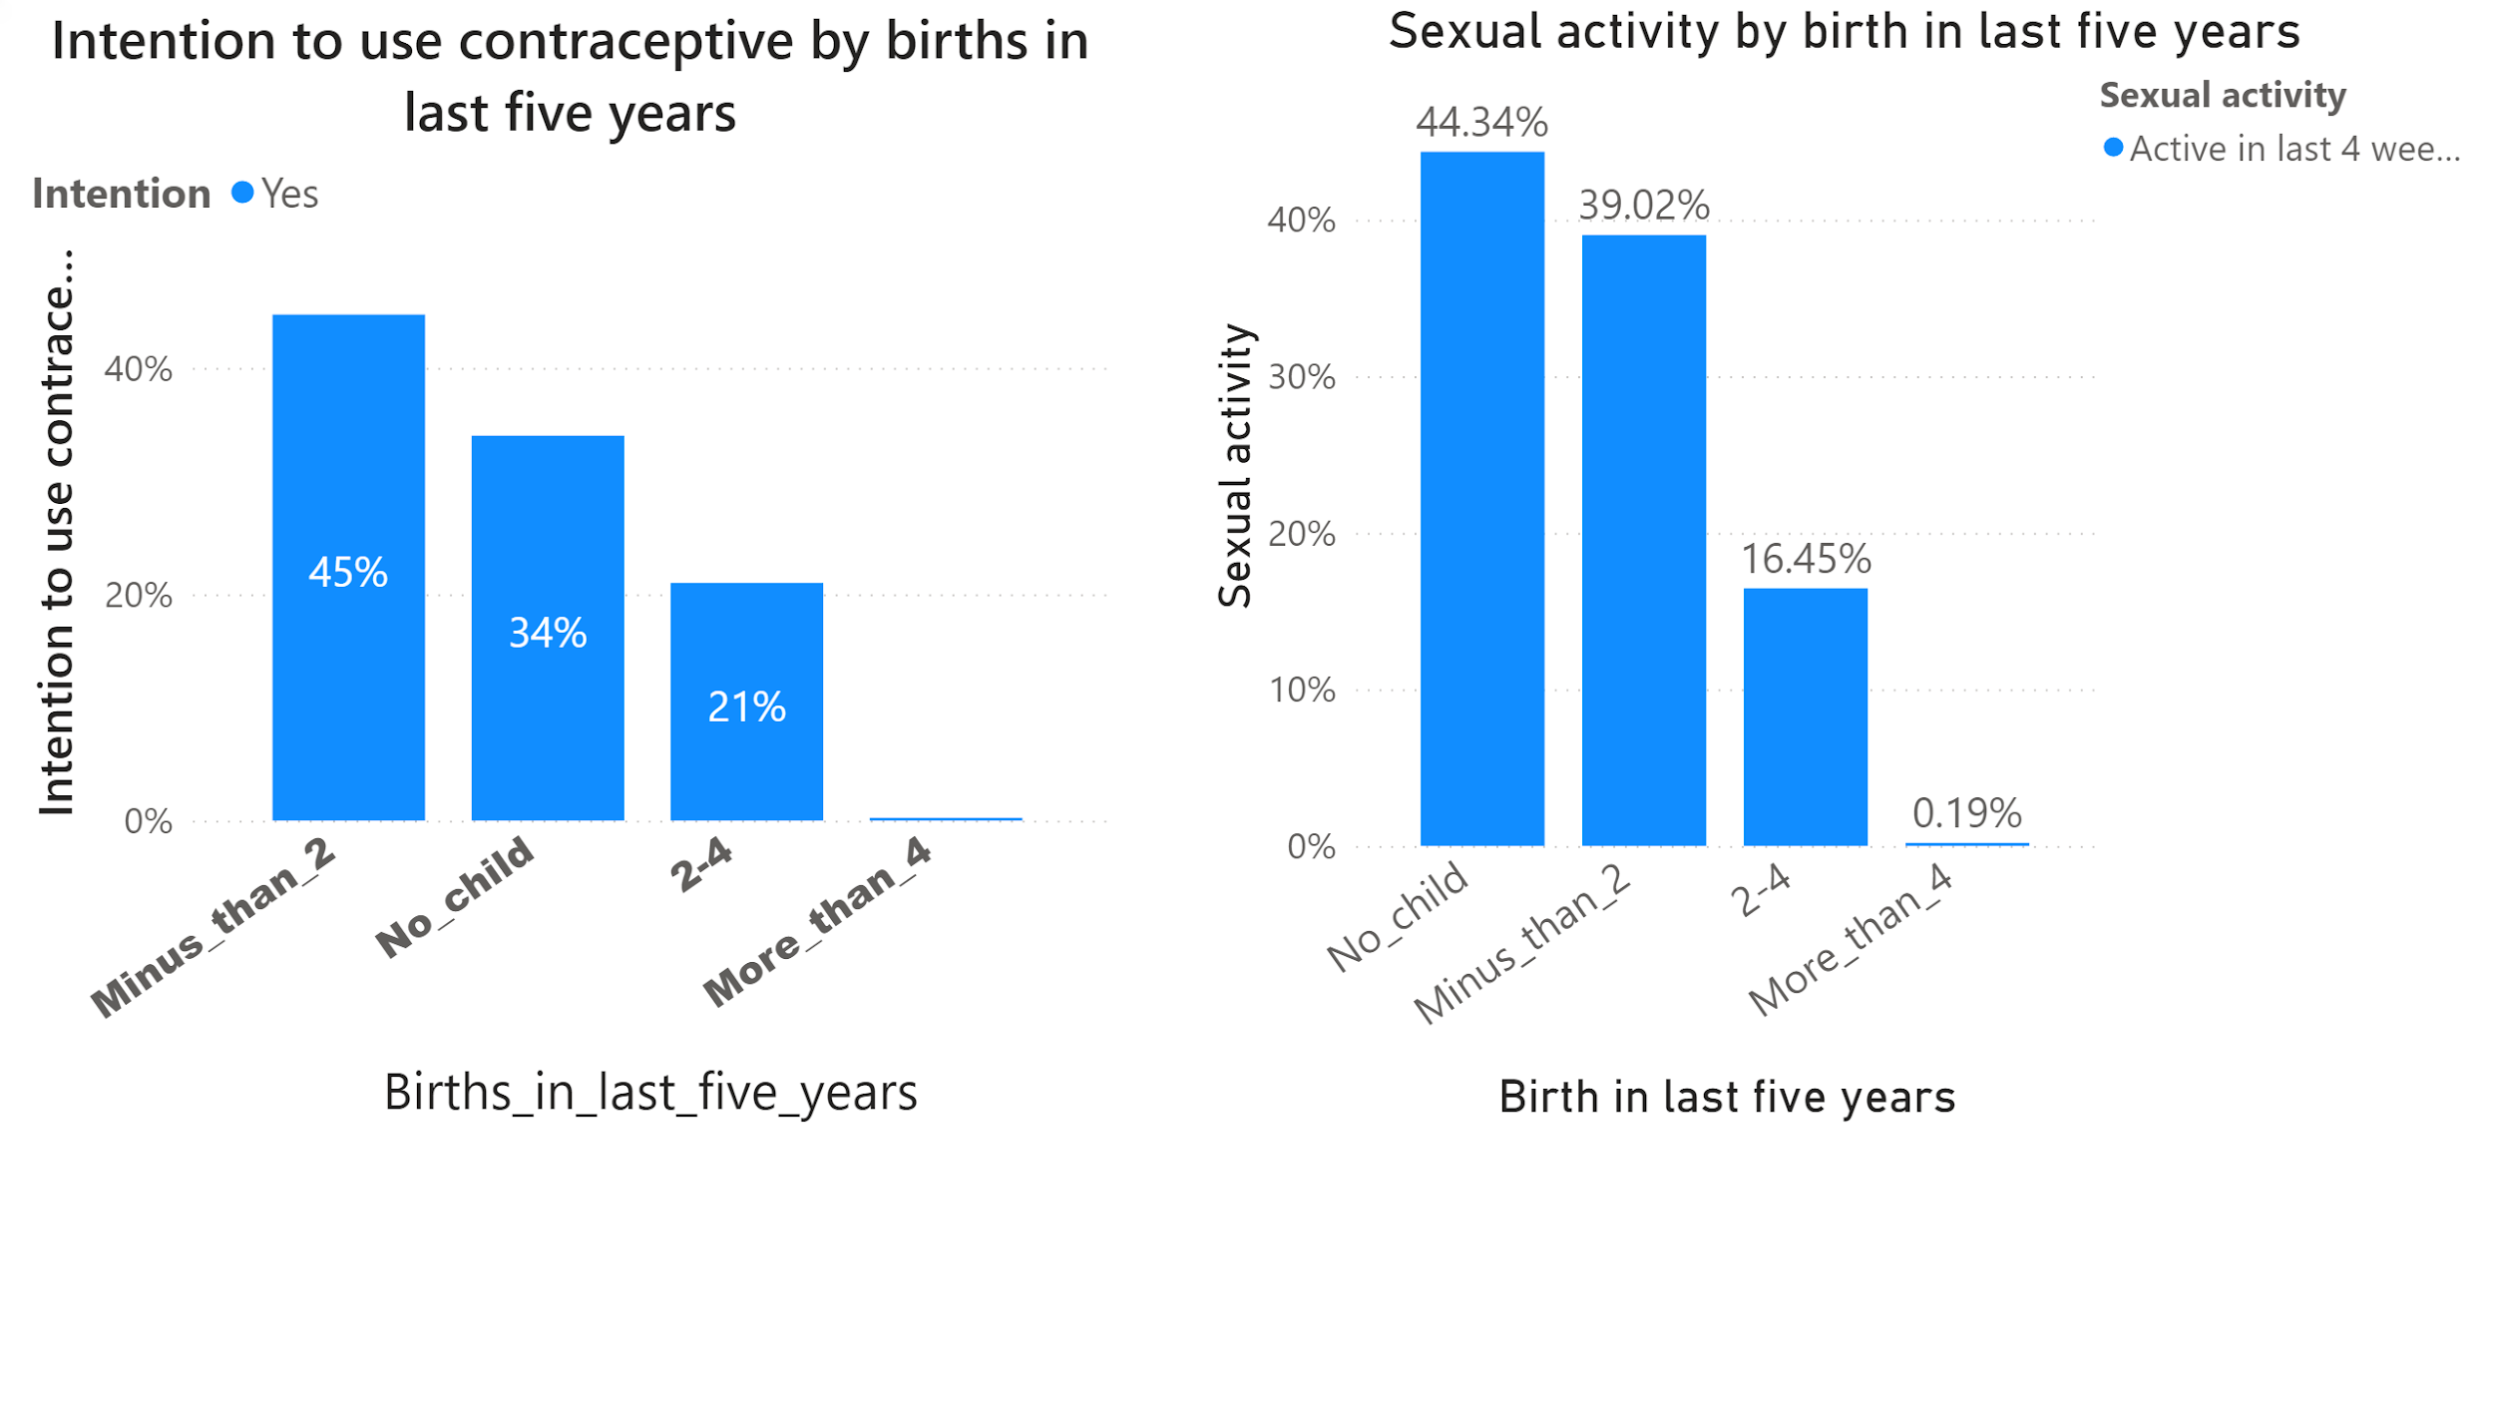

Slide 22
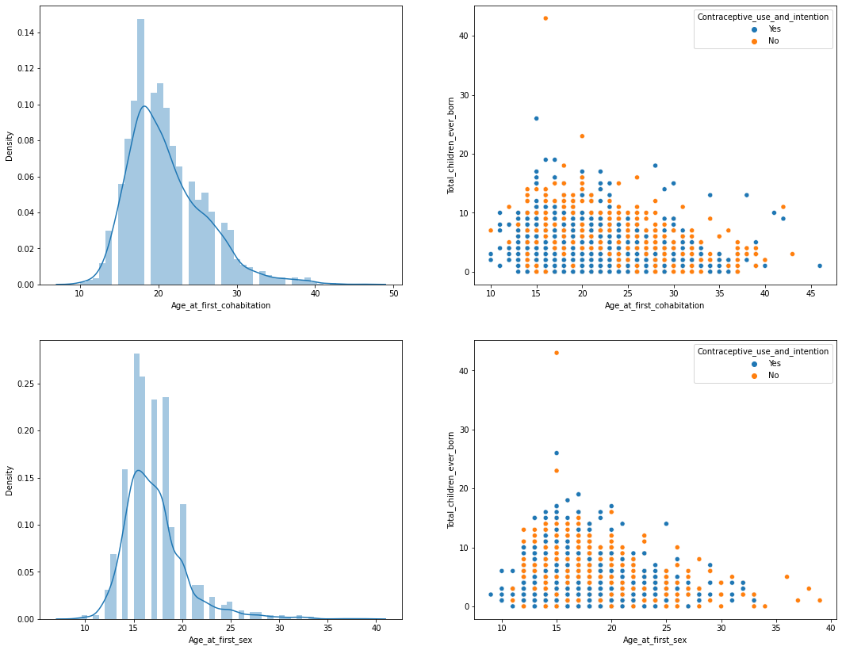
INTRODUCTION
They made their first experience of living-with-a-partner from very early (15-30) and they have more children
This category are strongly interested in MCM
They also started their sexual experiences at a very early age (14-20 years)
They give birth to more children and they are interested in MCM

Slide 23
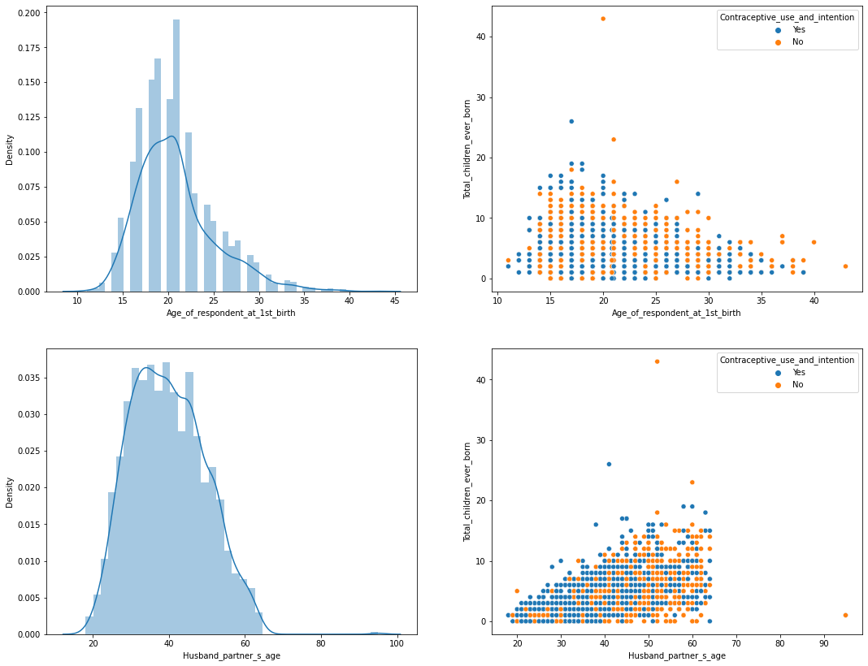
INTRODUCTION
Most of them gave birth to their first child between the ages of 15-30.
This category are strongly interested in CMM
Woman with aged husband gave birth to more children and are not interested to MCM when their husband’s age exceed 60

Slide 24

What actors could do ?
RECOMMANDATIONS
Intention to use a modern contraceptive method could be used as a monitoring indicator in programs
Social workers could use this work to better orient their contraceptive campaign
Assessment of contraceptive demand should take more account of the socio-demographic characteristics of women and their partners
Intention to use a modern contraceptive method could be used as a monitoring indicator in programs

